Slide 1

Core Java Programming
Amar Kumar Sharma

Slide 2
Why Java?
▹
Platform Independent: Bytecode runs on any device with a JVM. (Write Once, Run Anywhere).
▹
Object-Oriented: Based on objects and classes, ensuring clean, modular code.
▹
Robust Memory Management: Automatic garbage collection prevents memory leaks.
▹
Secure: No explicit pointers and runs inside a virtual sandbox.

Slide 3

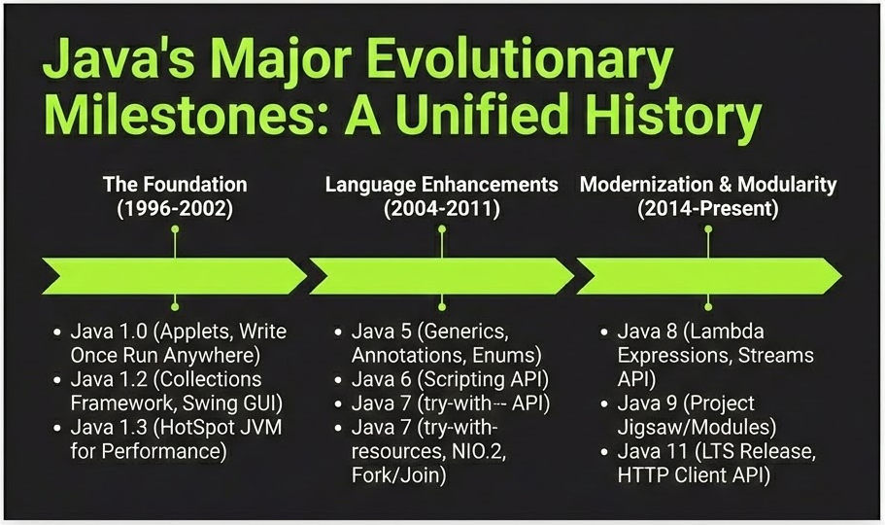
The Architecture
JDK vs JRE vs JVM
▹
JDK (Dev Kit): Contains tools (javac, debugger) + JRE.
▹
JRE (Runtime): Contains libraries + JVM. Needed to run apps.
▹
JVM (Virtual Machine): The engine that loads code, verifies it, and executes it.

Slide 4
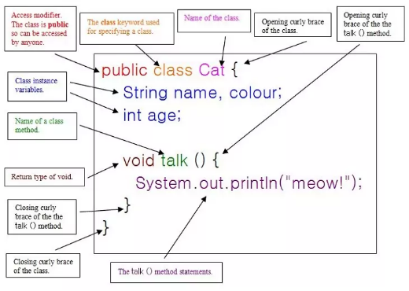
Class Anatomy
Variables (State)
▹
Local: Declared inside a method. Scope is limited to that method.
▹
Instance: Declared inside a class but outside methods. Specific to an object.
▹
Static: Declared with static keyword. Shared across all objects of the class.
Methods (Behavior)
▹
Definition: A block of code that runs when called.
▹
Signature: Includes visibility, return type, name, and parameters.

Slide 5






Types of Methods (Behavior)
Instance Methods
Static Methods
Abstract Methods
Belong to the object. Require an object to be created to call them. Can access instance variables.
Belong to the class. Called using . Cannot access instance variables directly.
Declaration only, no body. Used in Abstract Classes and Interfaces to enforce implementation in subclasses.

Slide 6

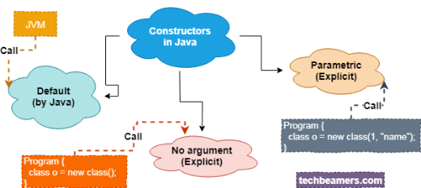
Initialization Logic
Constructors
▹
Special method used to initialize objects.
▹
Same name as the class and no return type.
▹
Default: No args, provided by compiler if none defined.
▹
Parameterized: Accepts arguments to set initial values.
Blocks
▹
Static Block: Runs once when the class is loaded.
▹
Instance Block: Runs every time an object is created.

Slide 7


Constructors & Types
Definition & Rules
Types of Constructors
A special method used to initialize objects. It runs automatically when the keyword is used.
▹
Default: Added by the compiler if no constructor is written. Initializes variables to defaults (0, null).
▹
No-Arg: A constructor explicitly written with empty arguments .
▹
Name must match the Class Name.
▹
Must not have a return type (not even void).
▹
Parameterized: Accepts arguments to initialize fields with specific values.
▹
Used to set initial values for object attributes.

Slide 8




Java Blocks
Instance Initialization (IIB)
Static Initialization (SIB)
A block defined inside the class but outside methods.
Defined using the keyword.
▹
Execution: Runs every time an object is created.
▹
Execution: Runs when the class is loaded by JVM.
▹
Order: Executes before the constructor.
▹
Order: Runs only ONCE per class lifecycle.
▹
Purpose: Common code shared by all constructors.
▹
Purpose: Initialize static variables.
Execution Flow: SIB (Once) → IIB (Per Object) → Constructor

Slide 9







The 4 Pillars of OOP
Encapsulation
Inheritance
Polymorphism
Abstraction
Wrapping data and methods into a single unit and restricting access via private fields.
Acquiring properties of a parent class to promote code reusability.
Performing a single action in different ways (Overloading & Overriding).
Hiding implementation details and showing only functionality (Interfaces).

Slide 10
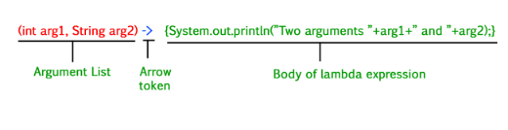
Lambda Expressions (Java 8)
Functional Programming
Introduced in Java 8 to enable writing more concise and readable code.
▹
Syntax: (parameters) -> expression
▹
Concept: Provides a clear and concise way to represent a method interface using an expression.
▹
Functional Interface: Works with interfaces that have only one abstract method (e.g., Runnable, Callable).
▹
Benefit: It cuts down a lot of extra, unnecessary code compared to anonymous inner classes

Slide 11







Types of Lambda Usage
No Parameter
Single Parameter
Used when the interface method has no arguments.
Parentheses are optional for a single argument.
Multiple Parameters
With Return Keyword
Used for operations like addition or sorting.
Explicit return requires curly braces.

Slide 12

Advanced Features
Collections Framework
Standard way to handle groups of objects.
▹
List: Ordered (ArrayList).
▹
Set: Unique (HashSet).
▹
Map: Key-Value (HashMap).
Multithreading
Executing multiple threads simultaneously to maximize CPU utilization.

Slide 13



The Collection Interface
List
Set
Queue
Ordered, Duplicates Allowed. Maintains insertion order.
Unordered, Unique. No duplicate elements allowed.
Processing Order. typically FIFO (First In, First Out).
Impl: ArrayList, LinkedList, Vector
Impl: HashSet, LinkedHashSet, TreeSet
Impl: PriorityQueue, ArrayDeque

Slide 14


Error Handling
Exception Hierarchy
Keywords
Java uses objects to represent errors.
▹
try: Code that might fail.
▹
catch: Code to handle the failure.
Throwable
├── Error (System crash)
└── Exception (Recoverable)
├── Checked (Compile-time)
└── Unchecked (Runtime)
▹
finally: Code that always runs.
▹
throw: Explicitly throw an error.
▹
throws: Declare potential exceptions.

Slide 15
Q & A
Thank you for listening.

